Slide 1
WORK OFFICE Alternatives Application
Adeputra Armadani., JNA., CND

Slide 2
work office ?

Slide 3
(writer, presentation, spredsheets)

Slide 4
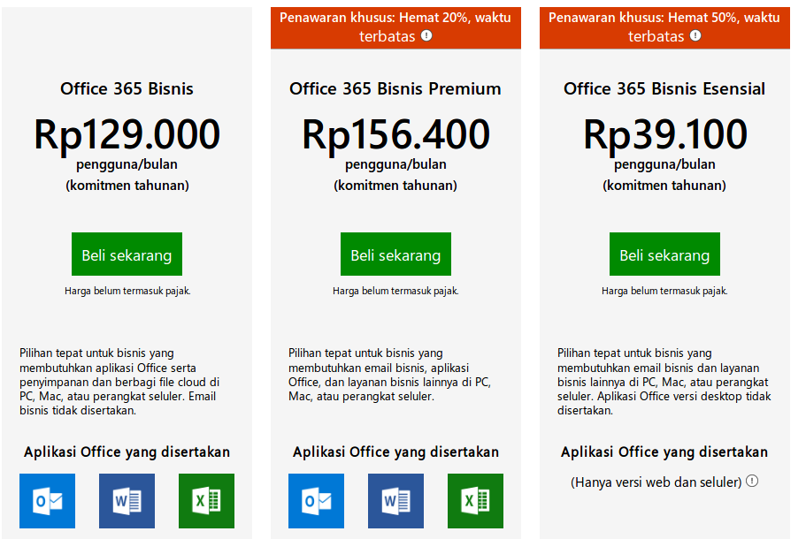

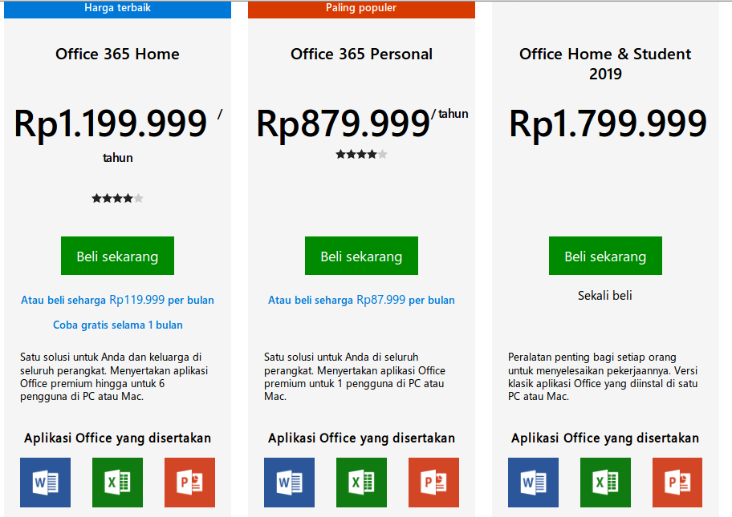
for bisnis
for home
for person
for student
microsoft lost cost becaus piracy
sumber

Slide 5
Alternative Application

Slide 6
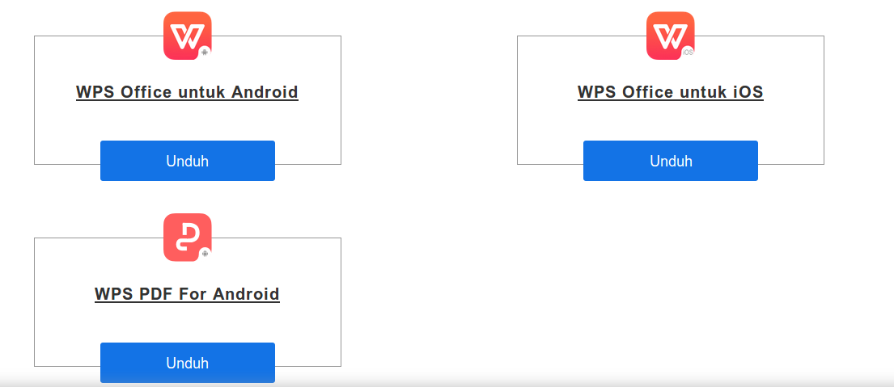

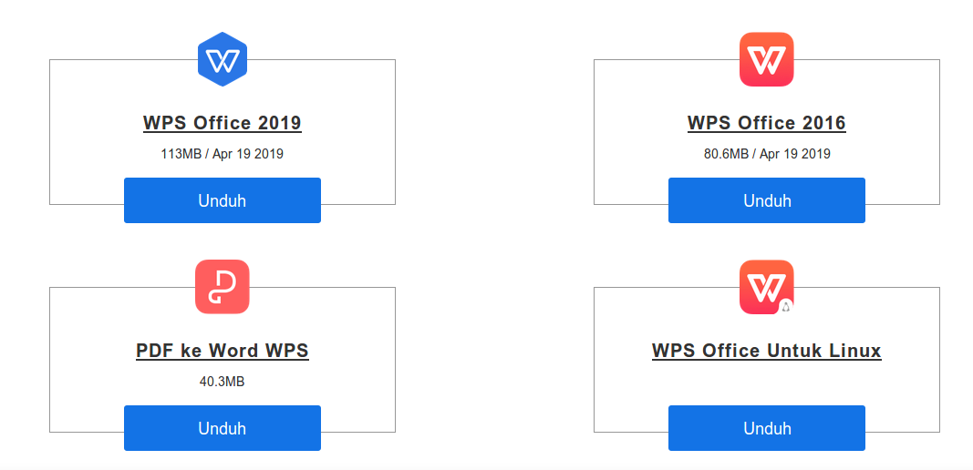
for android
for iOS
for windows
for linux
sumber

Slide 7

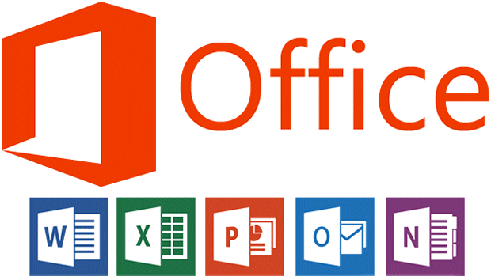


for student
Rp. 1.799.000
free
for you

Slide 8
Demo WPS Office
writer, presentation, spreadsheets

Slide 9
thanks
work office alternatives application opensource

Slide 10
cyber security tips
* aware of malware, trojan, ransomware, virus computer
* have to worry about suspicious files, new mail, file into flashdisk.
[solutions]
*identification, analysis, use anti-virus
*https://virustotal.com
*check code file md5hash

